Slide 1

Geodemographics
Alex D. Singleton, Seth E. Spielman, David C. Folch (2017) Urban Analytics. London: Sage.

Slide 2
Learning Objectives
There are two main approaches to urban analytics: the variable and contextual paradigms.
What are Geodemographic classifications?
Geodemographics have a long history of use within cities.
How can Geodemographics be used to summarize population and built environment characteristics?

Slide 3
Variables v Contexts
Contexts are the social, environmental, and economic settings within which we live our lives
Evolve over multiple time scales
Places shape access to opportunity and frame who we are; there is a lengthy history of studies that explore such “neighborhood effects” (Sampson 2012)

Slide 4
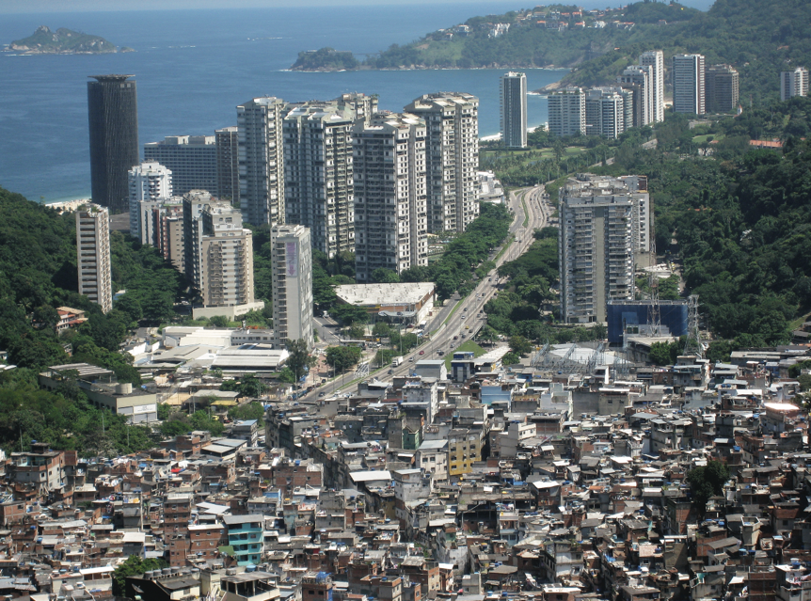
Variables v Contexts
The life chances of residents in the Rocinha favela are very different to those in more affluent areas of Rio de Janeiro, despite living in close proximity
Source: Photograph by AHLN CC BY-SA (Flickr)

Slide 5
Variables v Contexts
A variables mode of inquiry
seek to assess the influence of an abstract concept (e.g. as wealth or education) on some sort of outcome of interest.
A contextual mode of analysis sees neighborhoods as bundles of variables that are difficult to separate
Neighborhood-to-neighborhood differences are conceptualized as changes of type, rather than increments to variables, and additionally are more prevalently descriptive rather than explanatory.
Two types
Continuous measure of the constructs that they are designed to assess (see Lecture 10)
A categorical classification technique that is prevalently referred to as geodemographics

Slide 6
Geodemographics
Emerged in the 1970 in UK/USA
Commercialized in the 1980s
Typically summarize multiple characteristics about a set of small geographic areas
Multidimensional
But can be ranked by one or more composite or appended factors
Both an art and a science, and typically requires a degree of subjectivity in the exact choices of methods implemented to build them

Slide 7
Types of Geodemographics
General purpose
Describe urban structure within a national extent
Bespoke
Exploring the geography of a specific city or region
Or, for a particular substantive problem

Slide 8
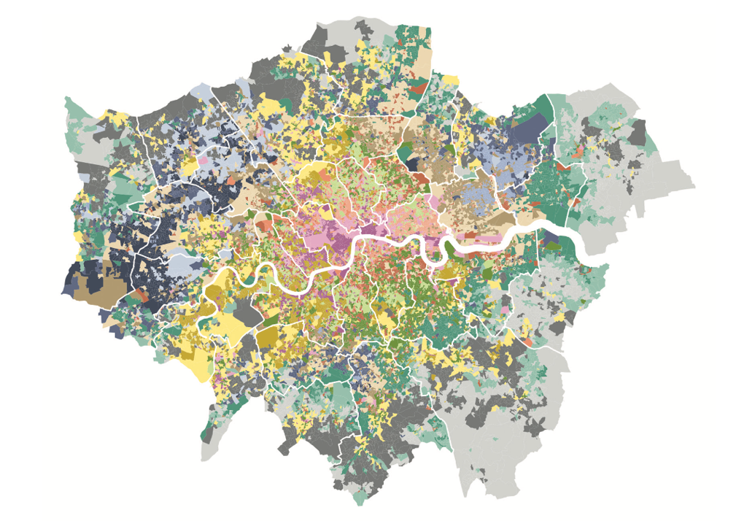
Geodemographics
The London Output Area Classification (LOAC) highlights 21 different types of areas and is created entirely from the 2011 Census of the Population
Source: Authors’ own; data – Office for National Statistics (2011)

Slide 9
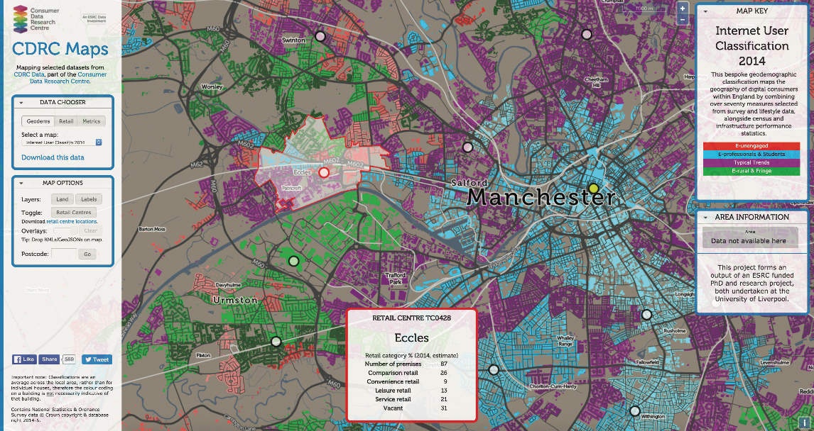
Geodemographics
The Internet User Classification being used to evaluate the exposure of retail centers to areas where populations are likely to shop online
Source: maps.cdrc.ac.uk uk is developed by Ollie O’Brien, University College London, UK.
Reprinted with permission.

Slide 10
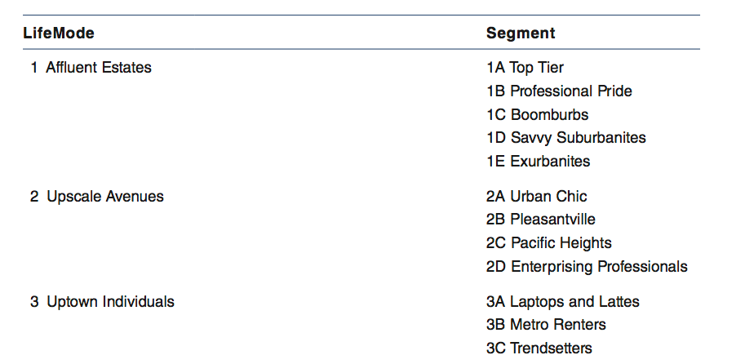
Presentation
Typically enable the greatest flexibility by organizing areas into increasingly aggregate clusters, thus forming a hierarchy
Tapestry Segmentation Hierarchy from Esri comprising “LifeMode” and “Segments”
Source: Copyright ©2017 Esri. All rights reserved. Tapestry is a trademark of Esri.
Reproduced with permission

Slide 11
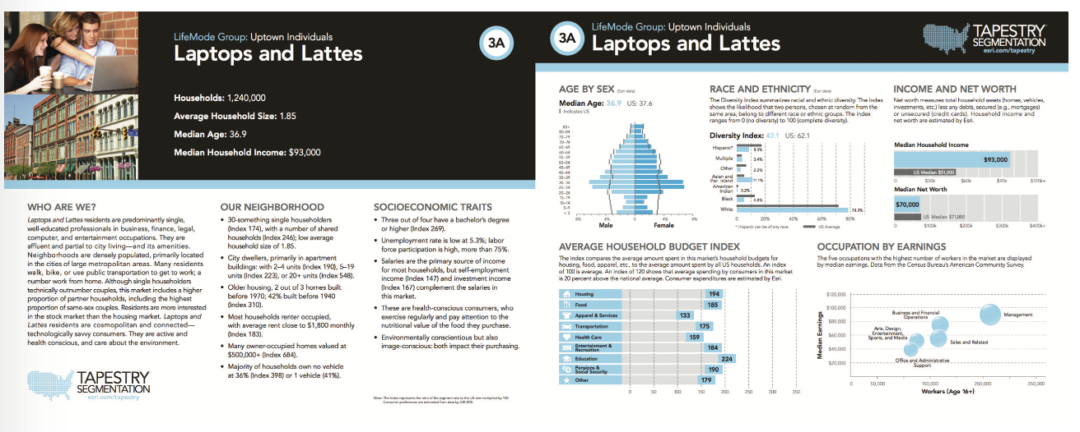
Presentation
Tapestry supporting materials showing photographs, descriptions, and graphics highlighting salient cluster characteristics
Source: Tapestry Segmentation image provided courtesy of Esri. Copyright © 2017 Esri. All rights reserved. Tapestry is a trademark of Esri

Slide 12
Creation Methods
There is no single method
But there are some commonalities in the decisions taken when creating classifications:
Gather a series of variables that are believed to be important to the differentiation of small areas.
Input variables are then converted into measures such as percentages, ratios, or index scores, and their distributions explored to examine a variety of attributes such as collinearity, coverage, statistical dispersion (e.g., variance etc.), and kurtosis (skew).

Slide 13
Creation Methods
Area similarity is assessed through a clustering process, which is applied either top down or bottom up
Clusters are then examined by appending the input or other data to them and exploring which attributes are over- or under-represented (relative to a base such as the national average)

Slide 14
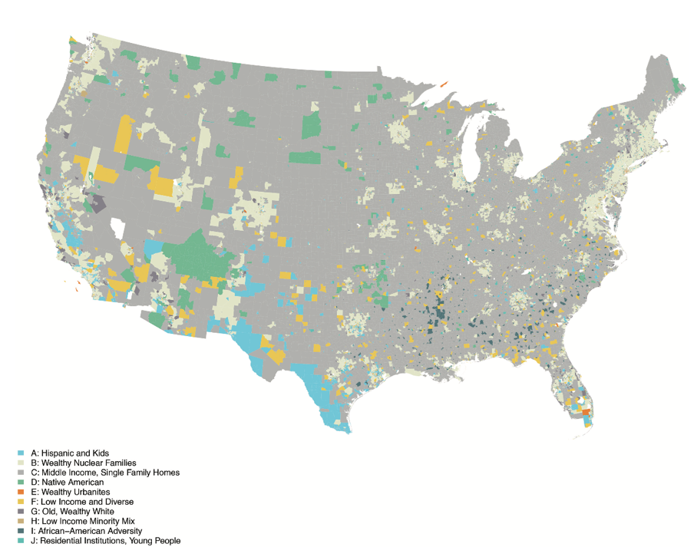
Case Study: US Open Geodemographic
An open geodemographic classification for the United States was created entirely from ACS data at a Census Tract scale
Source: Authors’ own; data – United States Census Bureau, American Community Survey

Slide 15
Conclusions
The contextual paradigm considers areas as bundles of attributes
Geodemographics describe the salient characteristics of urban areas
Their creation is both an art and a science

